Slide 1
Multi-Tenant Coworking Management SaaS
(Course Code: 25CS022)
Presented By:
Samyan Sharma (2411981646)
Arpit Khanal (2411981649)
Prakriti Shrestha (2411981652)
Nitesh Kumar Sah (2411981663)

Slide 2
Index
Introduction
Project Description
System Architecture & Design
Database Design
Data Flow Diagrams (DFD)
Features Implemented
Screenshots
Challenges Faced
Future Enhancements
Conclusion

Slide 3
Introduction
The Multi-Tenant Coworking Management SaaS is a web platform that lets independent coworking operators run their space on one shared application, while each space’s data stays isolated from every other space.
Members see a live floor plan, book desks and rooms, and pay online. Managers configure their space, pricing, and payouts. A platform administrator oversees every space.
Objectives
Tenant isolation enforced in the application layer, using a space ID taken from the JWT and re-verified on every request
Double-booking prevented by a PostgreSQL exclusion constraint, not just by UI checks
Real-time floor plan updates with Socket.io, one room per space
Automatic 95/5 payment split through Stripe Connect (test mode)
Soft delete instead of hard delete, so booking and payment history is preserved

Slide 4
Project Description
Project Overview
A Business-to-Business (B2B) SaaS platform for independent coworking operators
Each coworking space is a tenant; all tenants share one application and one database
A manager can hold only one live space at a time
Core Modules
Authentication and signup (manager creates a space, member joins one)
Space, Zone, and Desk / Room management
Booking with a 15-minute payment hold
Payments: Stripe Connect onboarding, split charges, retry, reconciliation
Real-time floor plan (Socket.io)
Lifecycle and administration: soft delete, cancel-and-refund, platform overview, public space directory

Slide 5
Project Description
Platform Administrator
Seeded account; no self-service signup
Views platform-wide metrics and lists every space
Drills into any space: zones, members, paginated transactions
Space Manager
Signup creates exactly one space with the manager account
Manages zones, desks, and rooms; sets hourly/daily prices for each item
Onboards to Stripe Connect; views space analytics
Renames or soft-deletes resources; affected bookings are cancelled and refunded
Member
Joins a space from a public directory
Books desks and rooms, pays by card, views own bookings

Slide 6
System Architecture & Design
Technology Stack
Frontend: Next.js 16 (App Router), React 19, Tailwind CSS 4, Zustand 5, socket.io-client, Stripe React SDK
Backend: NestJS 11, Prisma 7 with the pg driver adapter, JWT with bcryptjs
Database: PostgreSQL 16 with the btree_gist extension
Real-Time: Socket.io 4, one room per space, JWT-authenticated handshake
Payments: Stripe Connect (Accounts v2), Payment Element, webhooks; test mode only
Testing and Tooling: Jest, Vitest, Docker Compose

Slide 7
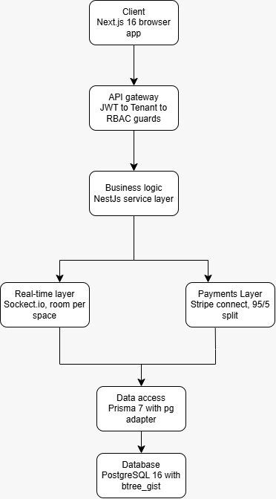
System Architecture & Design
Guard order: JwtAuthGuard, then TenantGuard, then RbacGuard on every request
Layers: Next.js client, NestJS services, Prisma, PostgreSQL
Real-time and payments branch off the business logic layer
Booking conflicts are decided in PostgreSQL, not in application code

Slide 8
Key Design Decisions
Tenant isolation
Shared schema; TenantGuard takes the space ID from the JWT, services re-check the relation chain
Double-booking
EXCLUDE USING gist over the booking time range; the database decides, the API returns 409
Payments
Destination charges with a 5% platform fee; card data handled only by Stripe
Data lifecycle
Soft delete (deletedAt); foreign keys on User and Booking set to RESTRICT; refunds on deletion

Slide 9
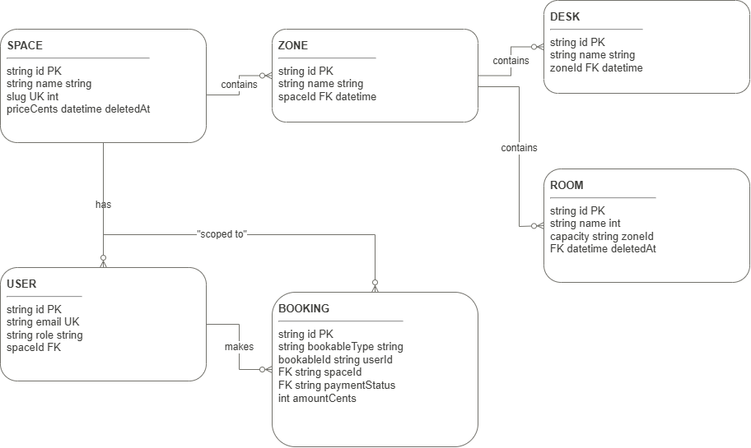
Database Design
Six entities: Space, Zone, Desk, Room, User, Booking. A booking points to a desk or room through bookableType and bookableId, with no foreign key.

Slide 10
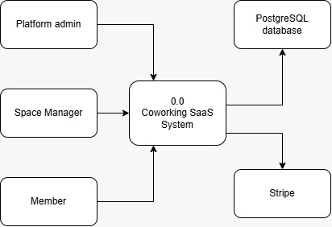
Data Flow Diagram: Level 0
Three actors and two external systems (PostgreSQL and Stripe) around one central process.

Slide 11
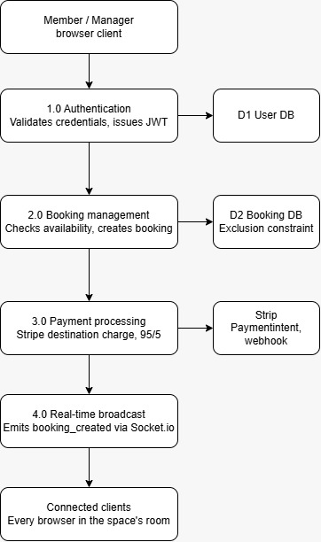
Data Flow Diagram: Level 1
Authentication: checks credentials, issues a JWT
Booking management: checks availability; the exclusion constraint blocks overlaps
Payment processing: Stripe destination charge (95/5); webhook updates status
Real-time broadcast: booking_created sent to the space’s Socket.io room

Slide 12
Features Implemented
Multi-tenant isolation: JWT-derived space ID, re-verified per request; 404 on cross-tenant access
Role-based access control: Platform Administrator, Space Manager, Member
Real-time floor plan: booking changes reach all connected clients
Conflict prevention: PostgreSQL exclusion constraint
Booking holds: slot reserved for 15 minutes awaiting payment
Stripe Connect payments: 95/5 split, retry, self-healing status reconciliation
Space analytics: revenue, utilization, 30-day trends, bookings per zone
Soft delete and cancel-and-refund: two-step confirmation, live floor plan removal
Admin overview and drill-down; public space directory

Slide 13
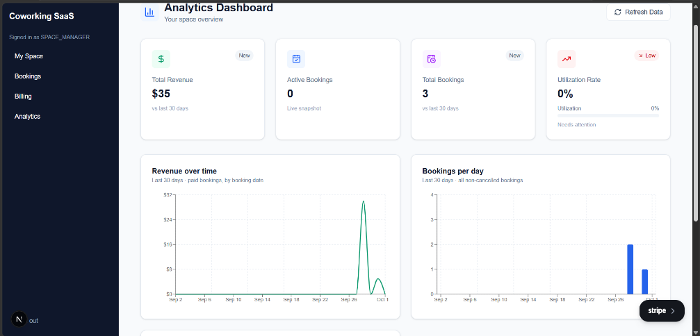
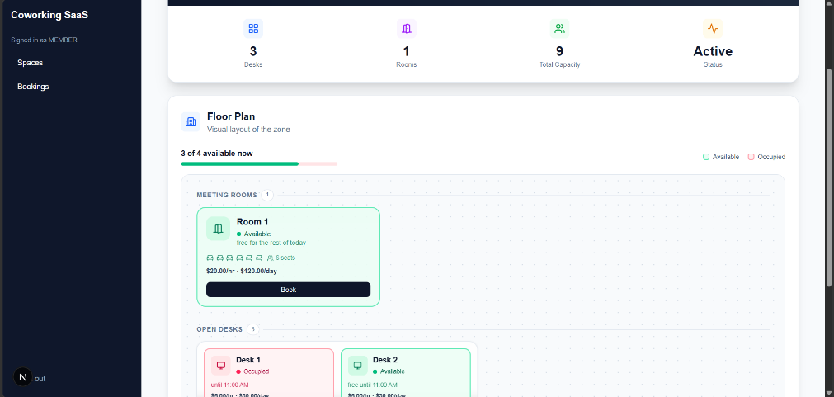
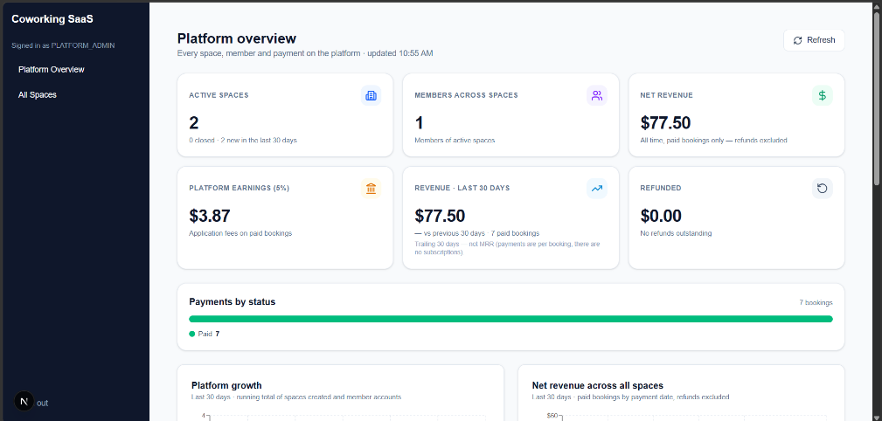
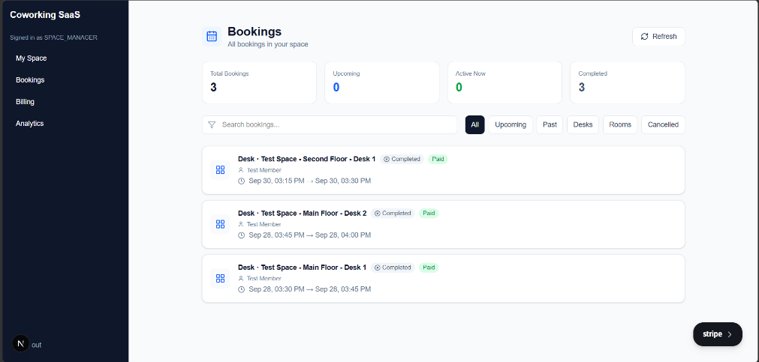
Screenshots
Manager analytics dashboard
Zone floor plan
Platform admin overview
Manager bookings list

Slide 14
Challenges Faced
Tenant isolation without database row security
Resolved with a two-layer guard: TenantGuard reads the space from the JWT, and each service re-verifies ownership through the relation chain.
Concurrent bookings
Resolved by moving the check into PostgreSQL with an exclusion constraint; the API maps the error to HTTP 409.
Stripe Connect onboarding restriction
Resolved by allowing a booking to be created unpaid and paid later while the account setup was fixed.
Soft delete versus financial reporting
Resolved with a stable Booking.spaceId reference, so revenue no longer depends on live desk or room rows.
Real-time payload exposing too much
Found in review: the broadcast included payment fields.

Slide 15
Future Enhancements
Space closure and recreation
Re-verify the booking overlap constraint on the live development database
Fix the start:prod script and add a backend .env.example
Add rate limiting and Helmet to login and signup endpoints
Refresh the stale end-to-end tests
Trim the real-time booking payload for non-owning members
Choose a hosting environment and deploy

Slide 16
Conclusion
The system delivers a working multi-tenant backend: JWT authentication, application-layer tenant isolation, a database-enforced guarantee against double-booking, real-time floor plans, and automatic Stripe Connect payment splitting. Soft delete with cancel-and-refund, a platform overview, and a public space directory are also merged. Only space closure and recreation remains from the approved scope.
Key Achievements
Application-layer tenant isolation with 404 rather than 403 on cross-tenant access
Race-condition-free bookings through a database exclusion constraint
Real-time synchronisation across connected clients
Automated 95/5 payments with retry and reconciliation
Soft-delete and refund lifecycle that preserves payment history

Slide 17
Thank You

